Slide 1
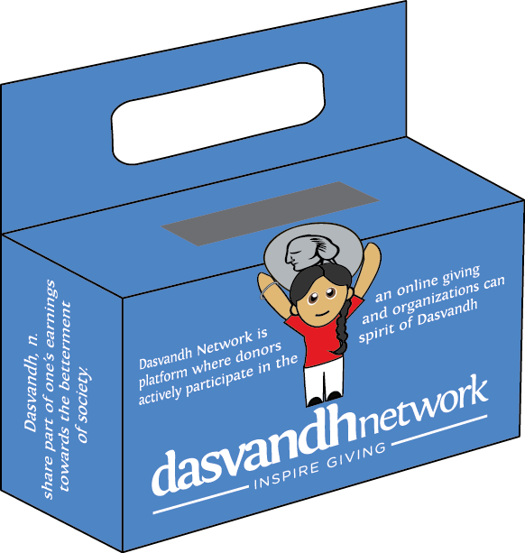
Dasvandh
Box Initiative
Gurdwara Liaison/Volunteer Presentation

Slide 2
LET’S TALK ABOUT IT
The Dasvandh Box Program
My role as a liaison/volunteer
Checklist
Have questions and Need Help?

Slide 3
THE DASVANDH BOX PROGRAM: Why are we doing this?
Dasvandh is a cornerstone of Sikh philosophy. Established with the concept of Vand Chakna by Guru Nanak Dev Ji, Dasvandh is the responsibility of every Sikh. For centuries Sikhs have participated in Dasvandh and have supported countless activities aimed at doing the Guru's work.
◆
More recently, however, young Sikhs growing up in North America have become less familiar with this duty. It’s our goal to educate Sikh youth about Dasvandh from an early age, so that they can participate in the spirit of Dasvandh as they grow and become working adults.

Slide 4
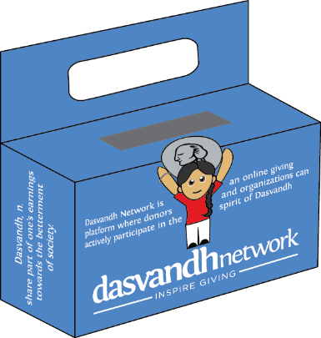
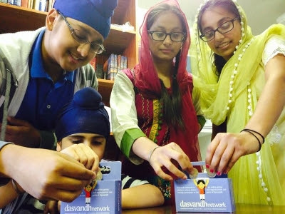
THE DASVANDH BOX PROGRAM:
Our Goals
Through the Dasvandh Box Program, we hope to:
Educate Sikh children on the meaning of Dasvandh
Encourage children to get used to the spirit of giving
Remind parents and families to continue to teach and act in the spirit of Dasvandh

Slide 5
THE DASVANDH BOX PROGRAM: How will this work?
This is a 6-week program
On the day the Dasvandh Box Program kicks off at a gurdwara/Khalsa school, the educator will present the meaning of Dasvandh and introduce the aspects of the program to the children.
The class will vote and select a project on the Dasvandh Network (DVN) website – all donations will be sent from the Gurdwara liaison to DVN in support of the chosen project.
The children will receive the boxes and take them home, collecting funds through a variety of means; they will keep track of raised funds through their weekly tracker.
Parents will also receive a letter explaining this initiative.
On a weekly basis, children will bring their boxes to class and the funds will be collected by the Gurdwara volunteer and recorded on a class chart.
At the end if the 6 weeks, the volunteer will log into dvnetwork.org to donate directly or mail in a check to donate funds to the project (see appendix).

Slide 6
Task | My Role as Gurdwara Liaison/Volunteer | When does this happen?
Contact School Educator | Connect with the Khalsa School President / Educator in person or on the phone to give them a high-level overview of the program, and why it’s important Send them the “Letter to Khalsa School” and a follow-up email Follow-up to: Solidify a date of when this event can be run at the Khalsa School Get the number of students at their school Get number of school educators | As soon as possible
Keep DVN Updated | Once you receive the date, number of students, and educators in each class, let us know We’ll send you a “Dasvandh Box” package that includes everything the school will need to launch the program | At least 2 weeks before the scheduled event
Discuss Details with the School Educator | After sending materials, please follow-up with school educator Ensure that the educator has informed teachers about giving the presentation and program. Address any questions, including have the presenter speak with Harleen Kaur (DVN Director of Education) about the lesson plan | At least 2 weeks before scheduled event
Take pictures / videos! | Please plan to be at the event and take pictures / videos and post to Facebook, tagging Dasvandh Network; please also email pictures and videos to info@dvnetwork.org | Launch Day
Assist with questions, collecting and counting donations | Check-in with the Gurdwara Sevadar / classroom as appropriate, ensuing they are regularly collecting the funds in a classroom jar and recording the donations Please ensure the appropriate Gurdwara Sevadar has collected and counted the funds at the end of the program | Throughout and end of program
Submit donations online through dvnetwork.org or mail | Instructions in “Appendix” at the end of the presentation | Within 1 week after the program ends

Slide 7
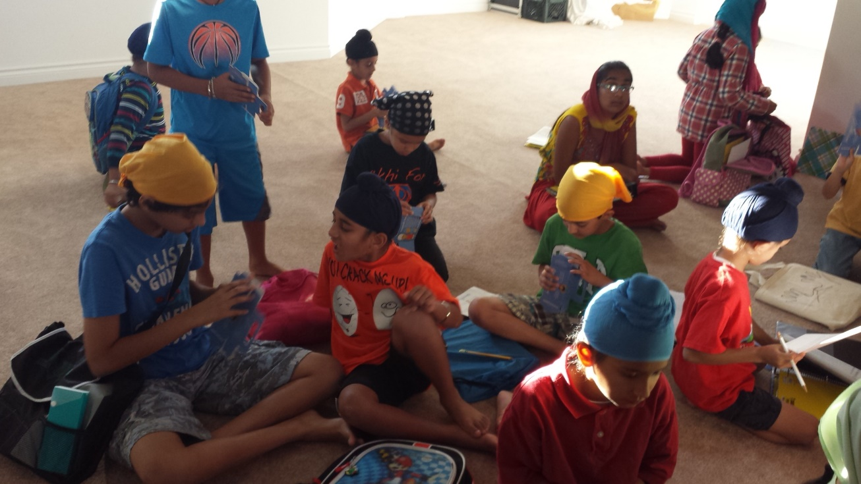
Questions?
We are here to help – do not hesitate to contact us with any questions:
info@dvnetwork.org

Slide 8
THANK YOU!
Without your support, launching this program would not be possible! Thank you for your help and your continued support in helping the Dasvandh Network do the Guru’s work and spread the meaning of giving throughout our community

Slide 9
APPENDIX

Slide 10
SUBMITTING A DONATION:
Online
Visit dvnetwork.org and create an account, or login using existing username and password
In the “Search” box, type in the name of the project the school selected
On the project page, beside the "Donate” button:
Type in the amount the school collected
Select “One-Time” for frequency
Click the “Donate” button
You have 2 ways to donate the school’s funds online
Submit via ACH (using your check details)
Submit by Credit Card
Once you submit, you should receive an “Order Confirmation” screen
Mail to DVN
You can mail in your check to Dasvandh Network. Checks should be written out to Dasvandh Network.
Mail the check to: 6002 Camp Bullis Rd San Antonio, TX 78257

